Slide 1







Technology Trends and Forecast
Anna Baniakina
3rd September 2023

Slide 2



OUTLINE
Executive Summary
Introduction
Methodology
Results
Visualization – Charts
Dashboard
Discussion
Findings & Implications
Conclusion
Appendix

Slide 3

EXECUTIVE SUMMARY
Current Trends
Future Skills in-Demand
Languages
Databases
Platforms
WebFrames
Findings and Implications
Learning and Career Development

Slide 4

INTRODUCTION
Annual Developer Survey
For current and future developers
Work prospective
Decision making
Languages
Databases
Platforms
WebFrames

Slide 5

METHODOLOGY
Data source : https://insights.stackoverflow.com/survey
All respondents of the survey
Comparison Current vs Next Year
Identify any biaised response in the analysis
For demographics, filter applied by Gender (Men or Women)
Countries
Age
Education level

Slide 6
RESULTS
Top 3 in-demand
Languages : JavaScript, HTML/CSS, TypeScript
Databases : PostgreSQL, MongoDB, Elasticsearch
Platforms : AWS, Android, Docker
WebFrames : Github, Confluence, Jira
Analysis to be completed with a survey on stakeholders demand since 83% of respondents are hobbyist.

Slide 7
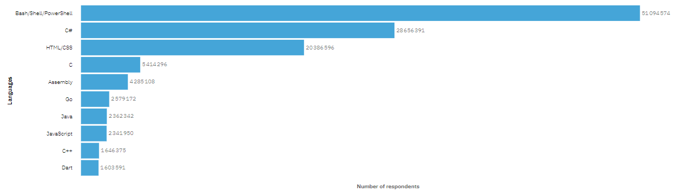
PROGRAMMING LANGUAGE TRENDS
Current Year

Slide 8
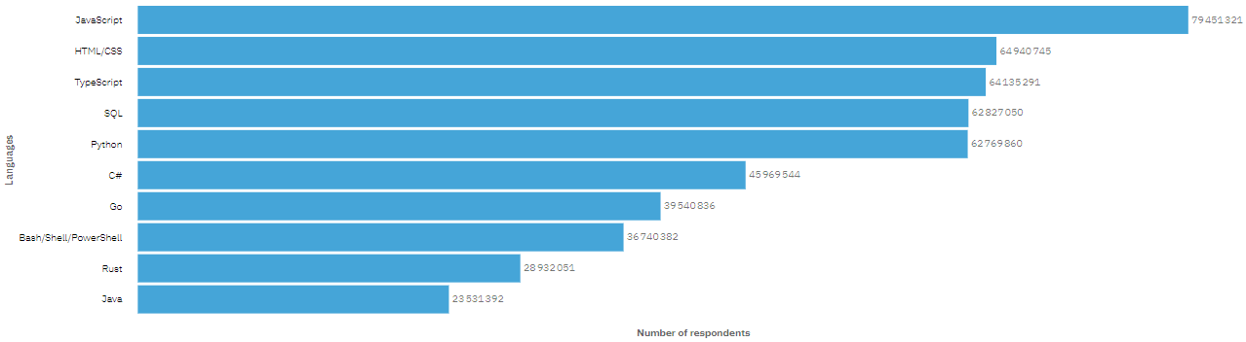
PROGRAMMING LANGUAGE TRENDS
Next Year

Slide 9
PROGRAMMING LANGUAGE TRENDS - FINDINGS & IMPLICATIONS
Findings
Dynamic interactions in-demand
Frontend in-demand
TypeScript in-demand
Implications
Debugging : HTML, C#
Data storage and cybersecurity
Learn JavaScript, handle red wavy lines and compilation errors

Slide 10
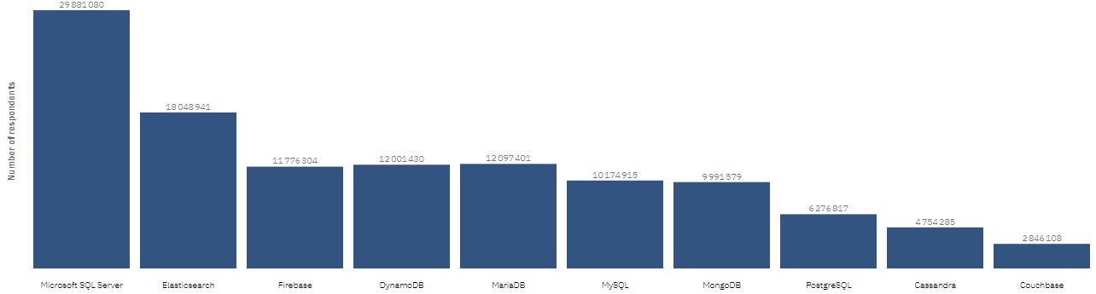
DATABASE TRENDS
Current Year

Slide 11
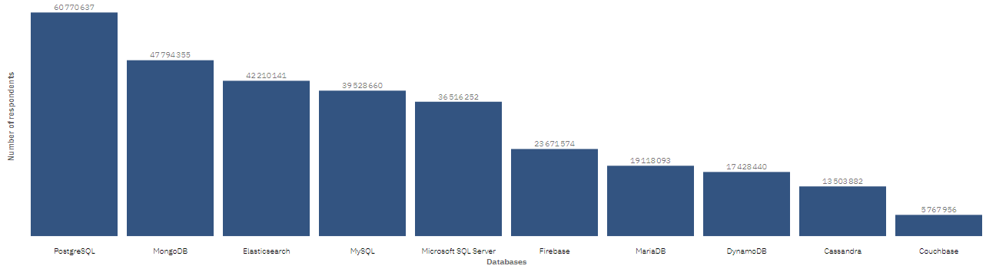
DATABASE TRENDS
Next Year

Slide 12
DATABASE TRENDS - FINDINGS & IMPLICATIONS
Findings
Open source in-demand
Document oriented
Indexation and Search
Implications
Cybersecurity
Indexation and data storage
Learn Java

Slide 13
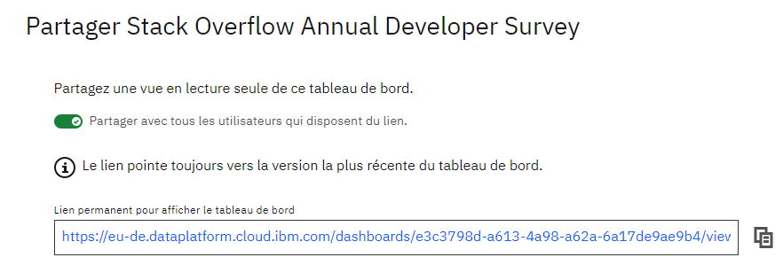

Stack Overflow Annual Developer Survey
https://eu-de.dataplatform.cloud.ibm.com/dashboards/e3c3798d-a613-4a98-a62a-6a17de9ae9b4/view/4f11e11831ec2cc95fead0e4079e24037e3e705bb6bbd200d6d37b495d677997f0691bc4c829480c8c115364f4b91b0a98

Slide 14
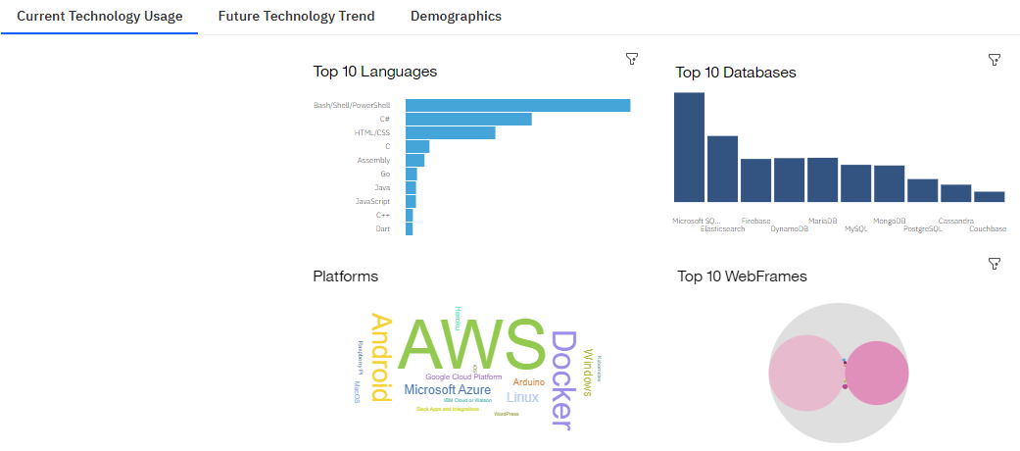
Current Technology Usage

Slide 15
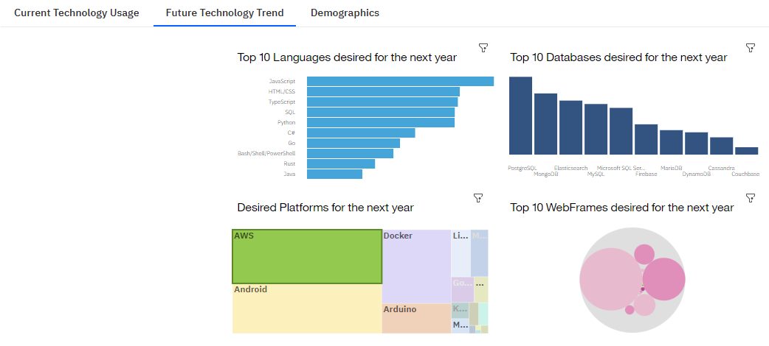
Future Technology Trend

Slide 16
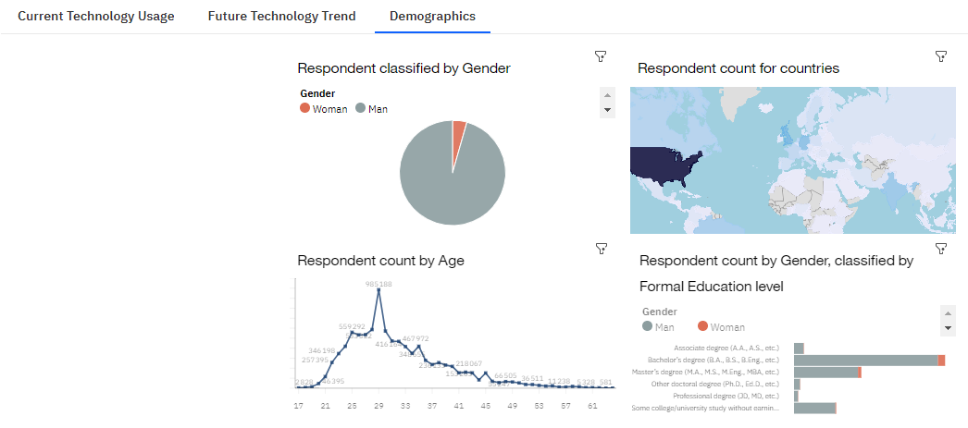
Demographics

Slide 17
DISCUSSION – ENHANCE SECURITY MEASURES
cyber security
off-site Data storage
compliance with laws and regulations
Ethics using AI

Slide 18
OVERALL FINDINGS & IMPLICATIONS
Findings
Moving towards Object-Oriented Programming
Web development in progress
Disparity in Gender and Education level of respondents
Biaised survey due to 83% being hobbyist
Implications
Data storage, Learning
Cybersecurity measures
Demographics and economy
Need to do an additional survey on stakeholders demand

Slide 19

CONCLUSION
Object-oriented programming in-demand
Front-end in-demand
Handling document indexation
Disparity in Gender and Education level
Data storage and cybersecurity issues
Need to do an additional survey on stakeholders demand

Slide 20

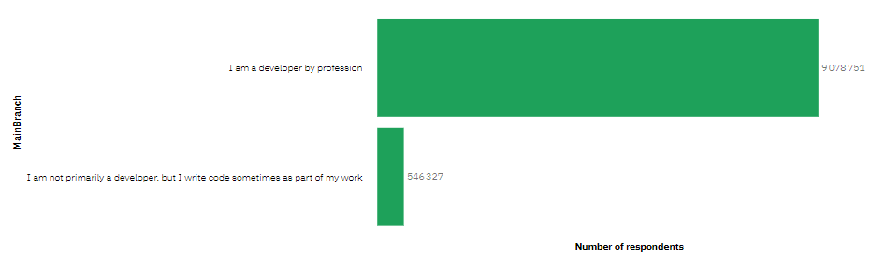
APPENDIX
Main Branch

Slide 21
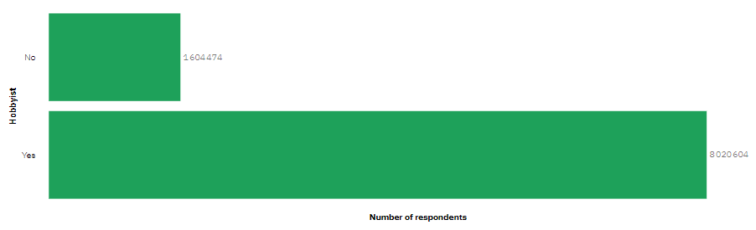
APPENDIX
Any hobbyist?

Slide 22
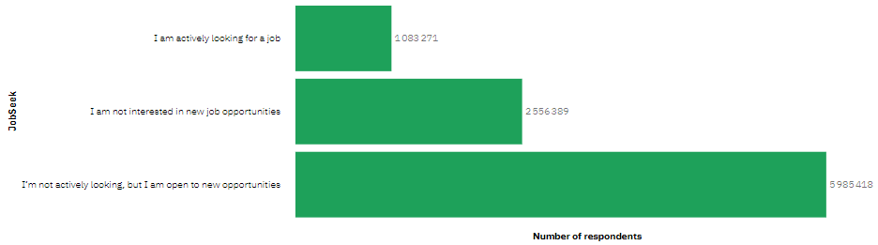
APPENDIX
Job Seeker

Slide 23
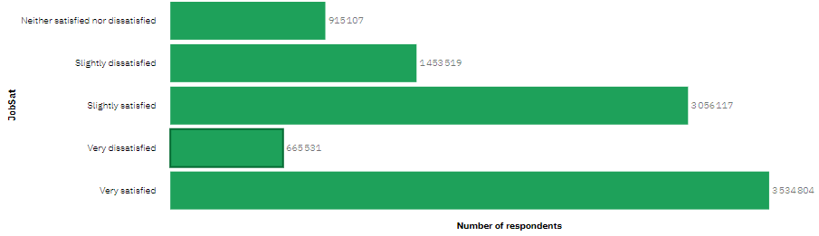
APPENDIX
Job Satisfaction

Slide 24
JOB POSTINGS

Slide 25
POPULAR LANGUAGES

